Slide 1


Team 37: Microhistological Analysis of the Dietary Habits of Sheep: GrazeView AI
Bi-Weekly Update 1
Godson Edewor, Arnav Gokhale, Jack Nelson, and Nate Scott Sponsor: John Lusher TA: Sabyasachi Gupta
Notes:
Michelle

Slide 2
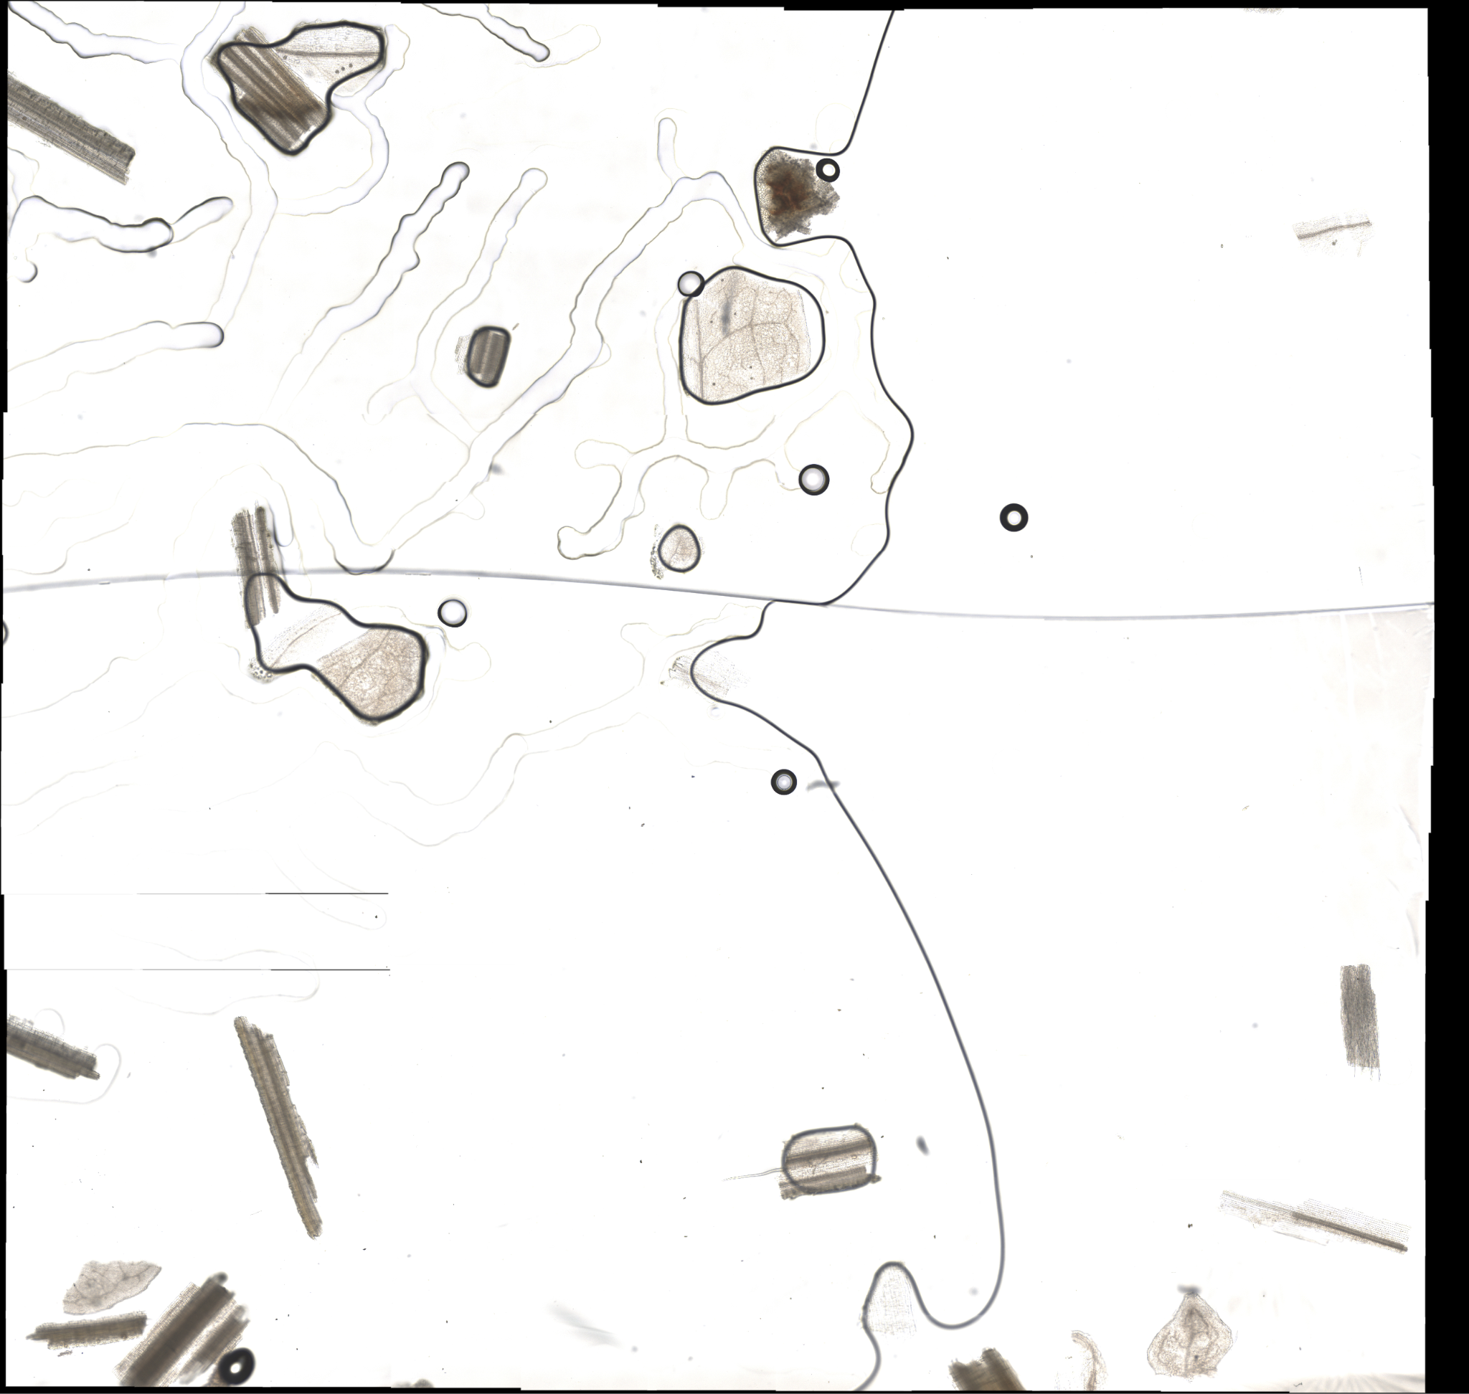
Project Summary
Problem Statement:
TAMU AgriLife is currently investigating the Dietary Habits of Sheep and the effect it has on their wool.
This can be a very time consuming effort, when analyzing microscopic samples by hand.
Solution Proposal:
GrazeView AI will allow the process of analyzing these microscope slides to become automated.
This will save TAMU AgriLife both time and money spent in training individuals that analyze by hand.
Notes:
Kyle

Slide 3
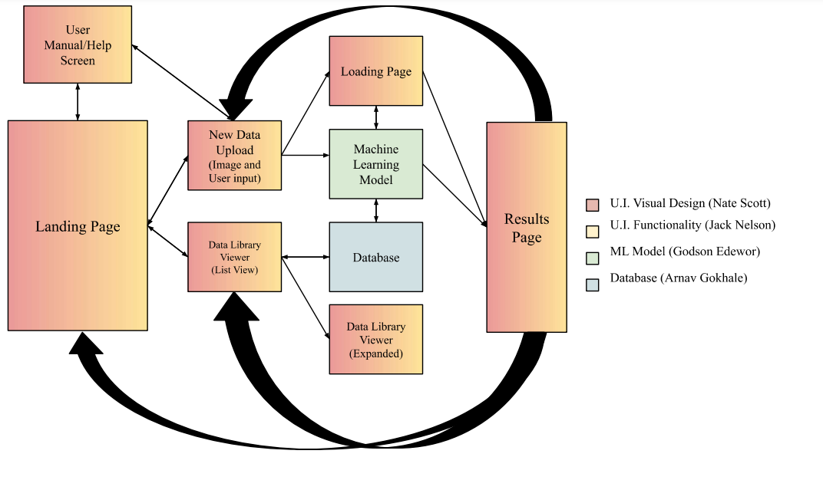
Project/Subsystem Overview
Notes:
Eric

Slide 4
Major Project Changes for 404
No Planned Major Changes for 404
Notes:
Eric

Slide 5
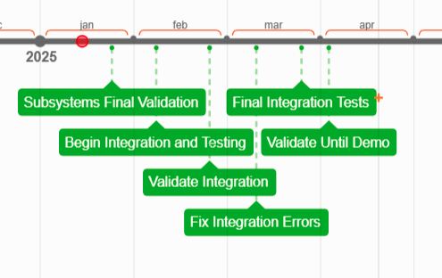
Project Timeline
Notes:
Eric

Slide 6
U.I. Functionality
Jack Nelson
Accomplishments since 403 [~70 Hours] | Ongoing progress/problems and plans until the next presentation
User Inputs are validated and stored Data Library stores all uploads in an organized manner Uploads can be printed in an organized manner Data Library can be cleared Results are shown in an organized manner Loading Screen provides real time updates* Data is stored after application close* | Reduce application lag Adjust application details to allow for user ease of use Finalize resizing events across the application Prepare points within the code to allow integration
*(These aspects of the application are for demo purposes only)

Slide 7
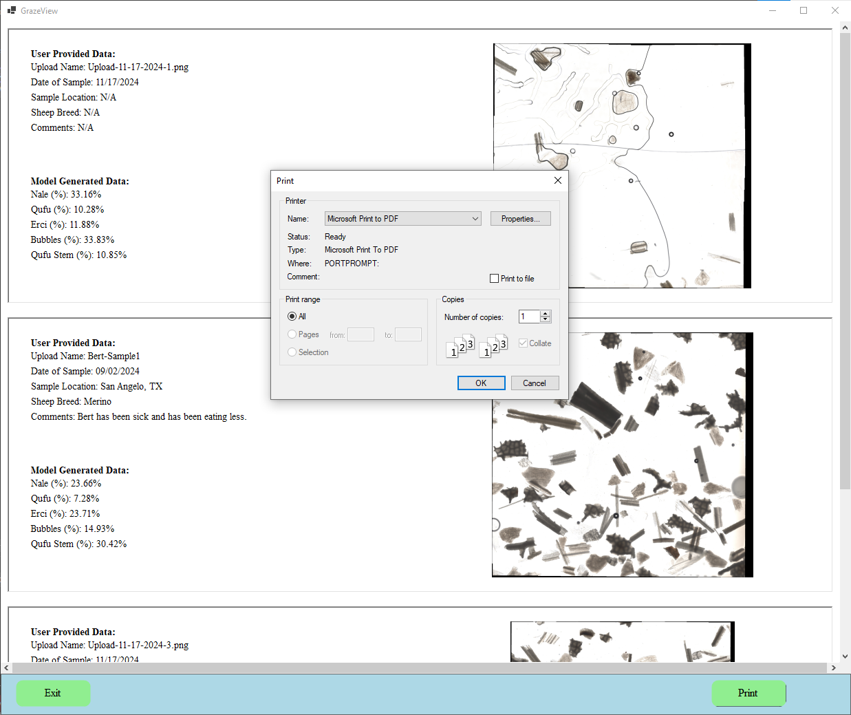
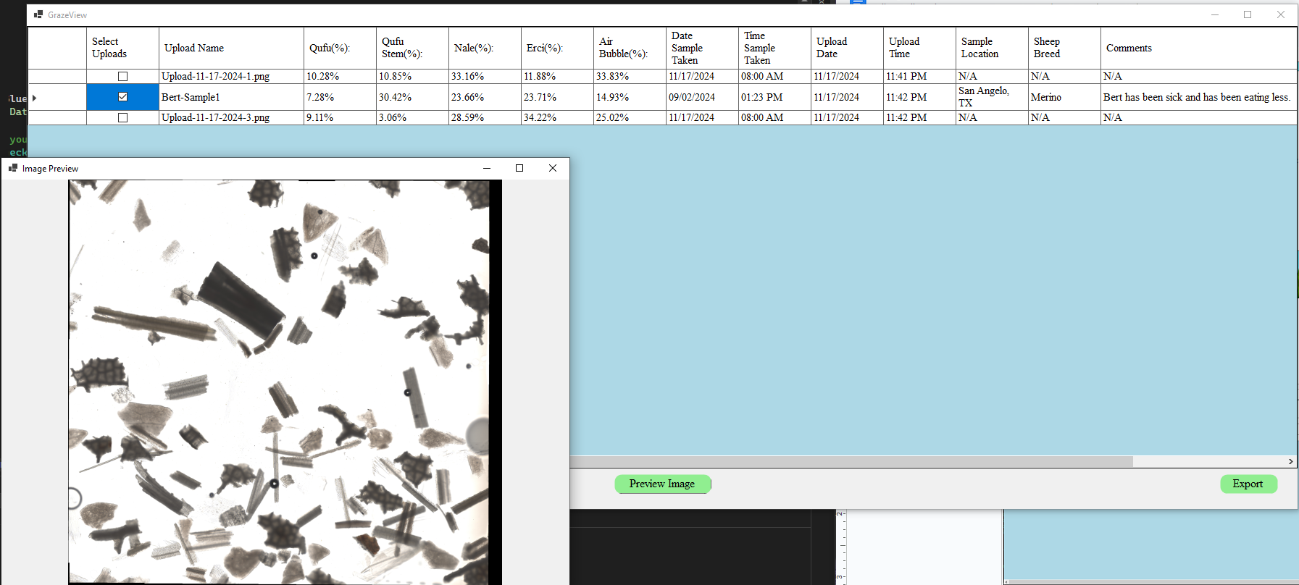
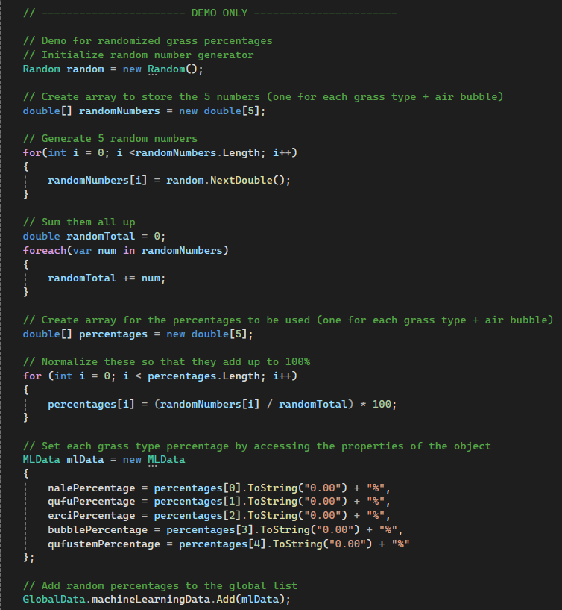
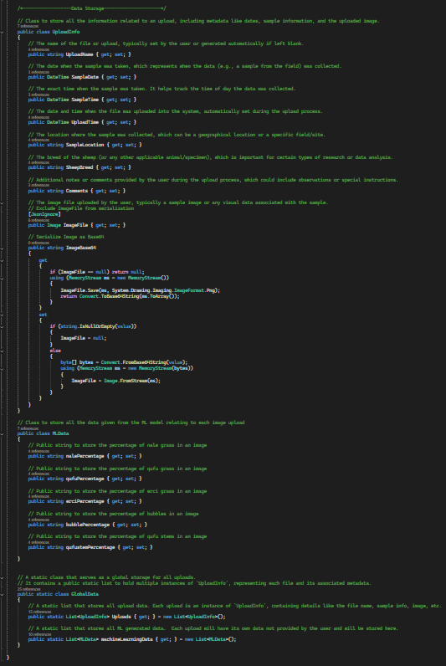
U.I. Functionality
Jack Nelson

Slide 8
Database
Arnav Gokhale
Accomplishments since 403 [~70 Hours] | Ongoing progress/problems and plans until the next presentation
Qufu Database complete Qufu Stem Database Complete Erci Database complete Nale Database complete Air Bubble Database complete Image Database Complete All Databases are automated Image Splicer renders an appropriate bounding box | Repurpose demo code Increase accuracy for smaller objects in picture Receive classifications from ML, add to DB Work with dataviewer to build an efficient pipeline Identify specific points of transfer of information in code Integrate into SQL

Slide 9
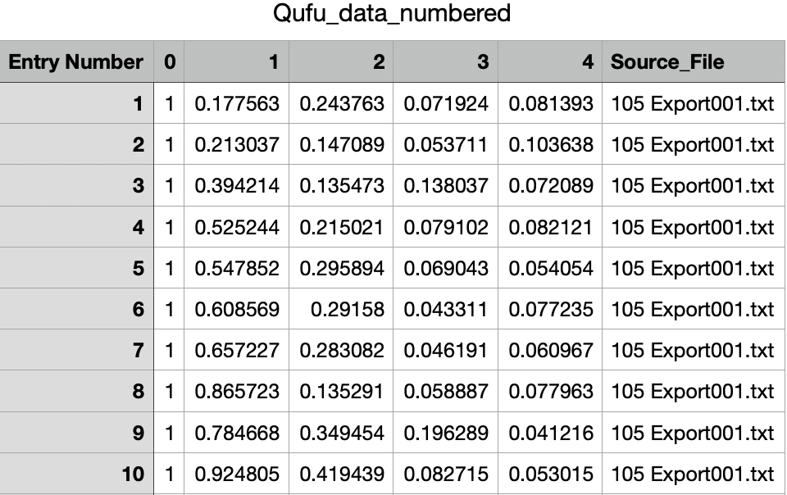
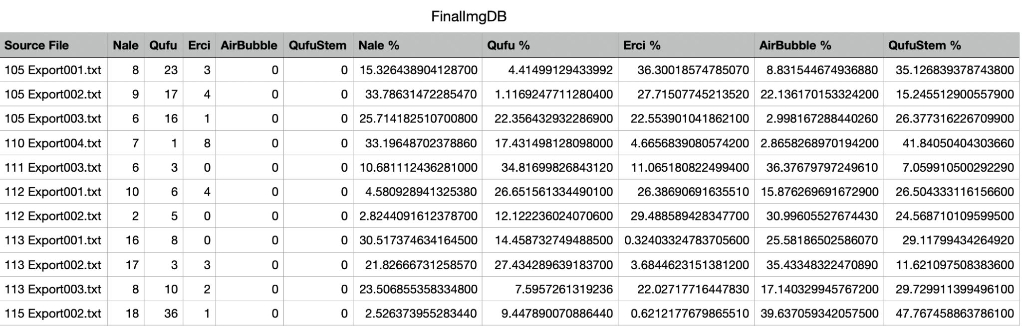
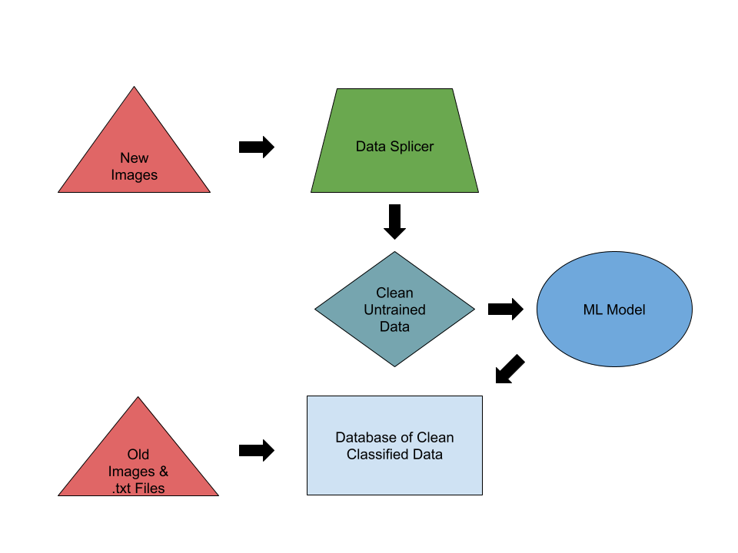
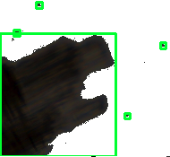
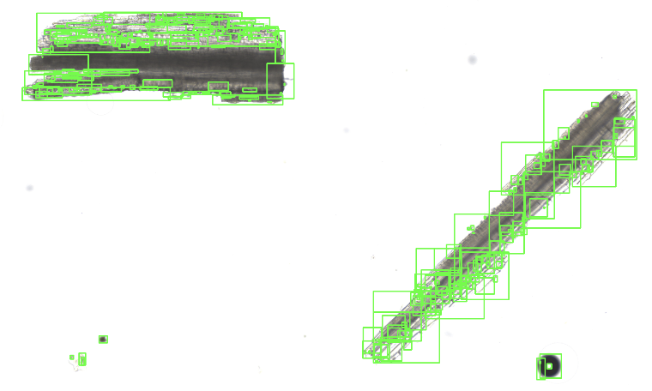
Database
Arnav Gokhale

Slide 10
U.I. Visual Design
Nathan Scott
Accomplishments since 403 [~70 Hours] | Ongoing progress/problems and plans until the next presentation
Designed all pages to be seen by the user Placed and positioned all components (buttons, labels, textboxes, panels, etc.) Resize components with respect to the size of the page Apply background design for most pages (colors, images, logos, etc.) Assigned consistent properties across all forms, components, text, etc. Embedded visual design resources locally (within the project) | Apply background design to the Results Page (was removed for the 403 demo due to lag) Fix a form resizing issue on the Data Upload page Ensure resizing the form stays consistent across all screen resolutions Rename components for clearer ease of use

Slide 11
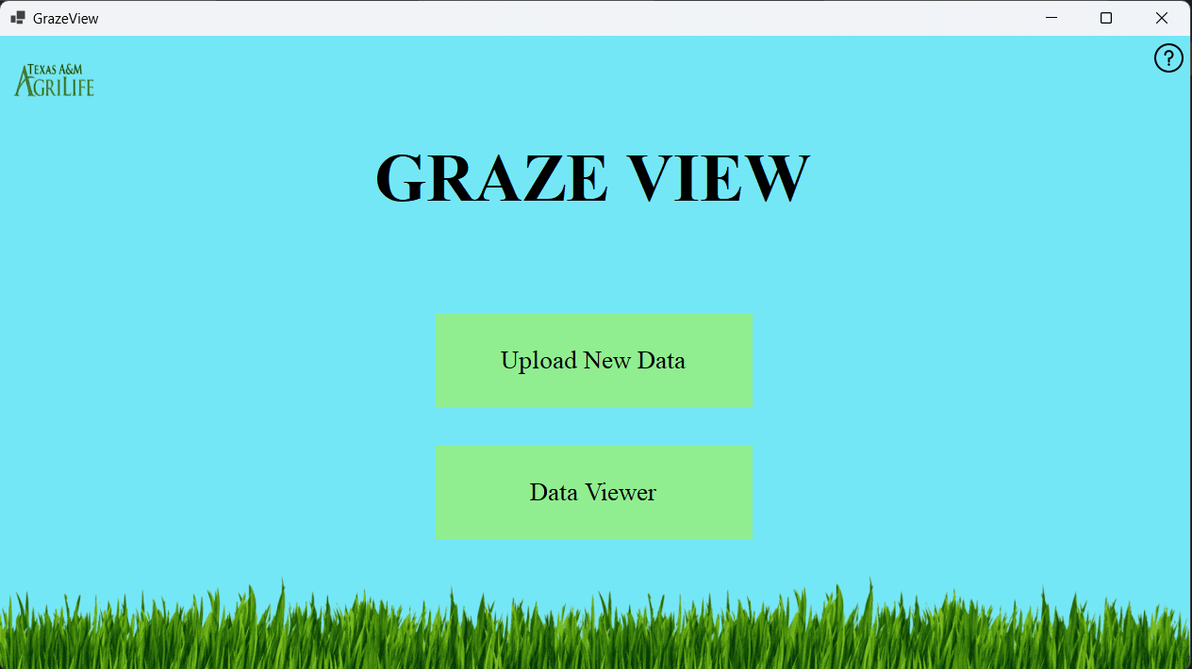
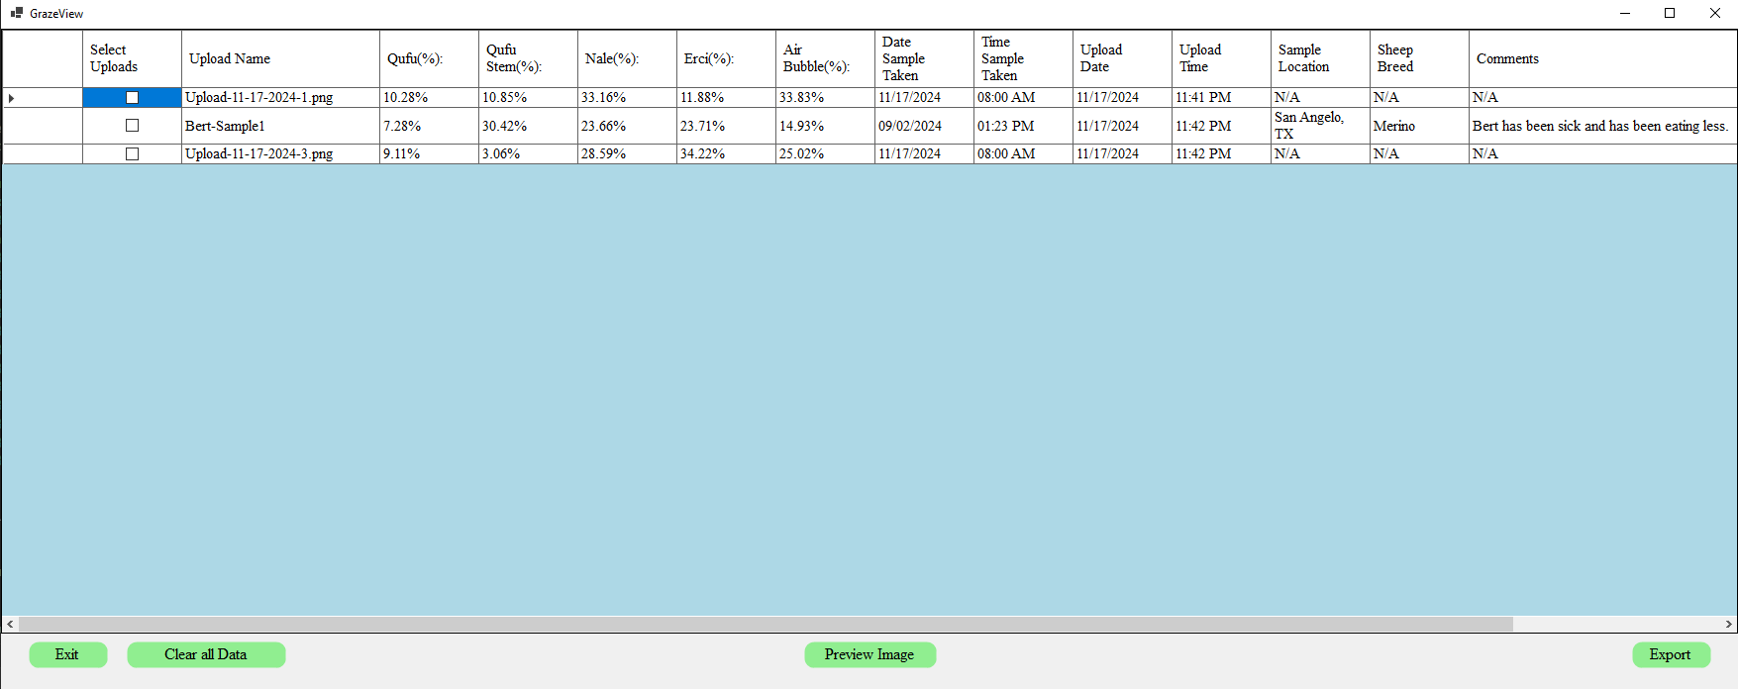
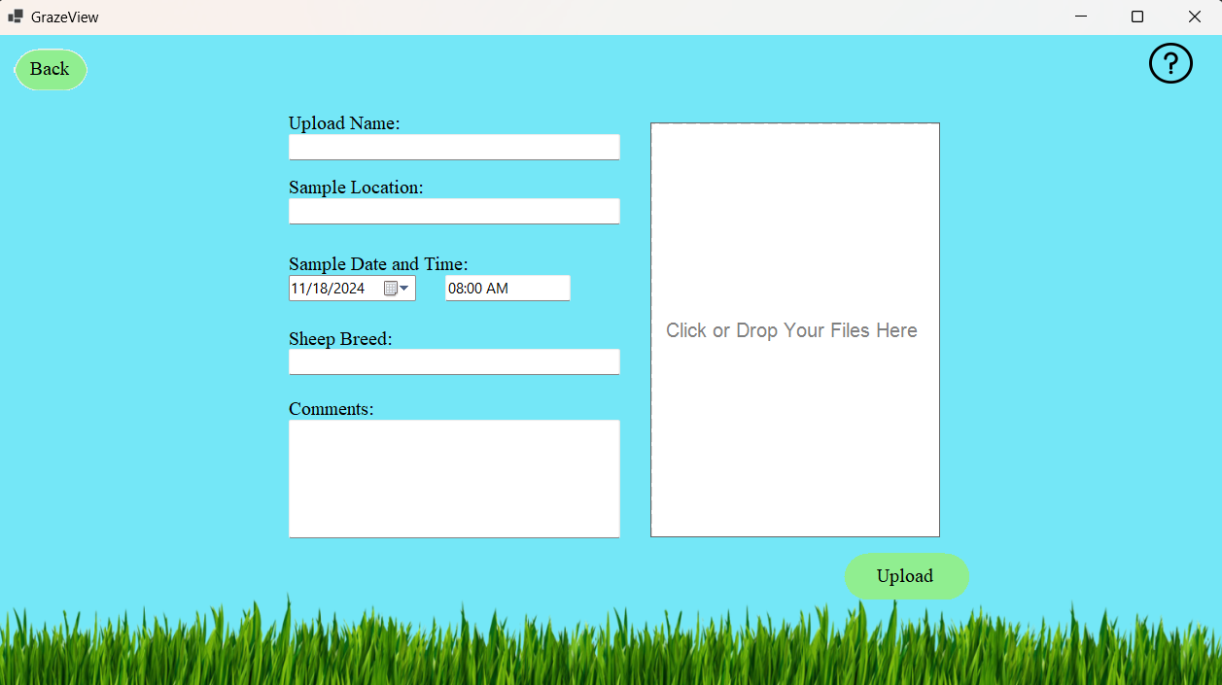
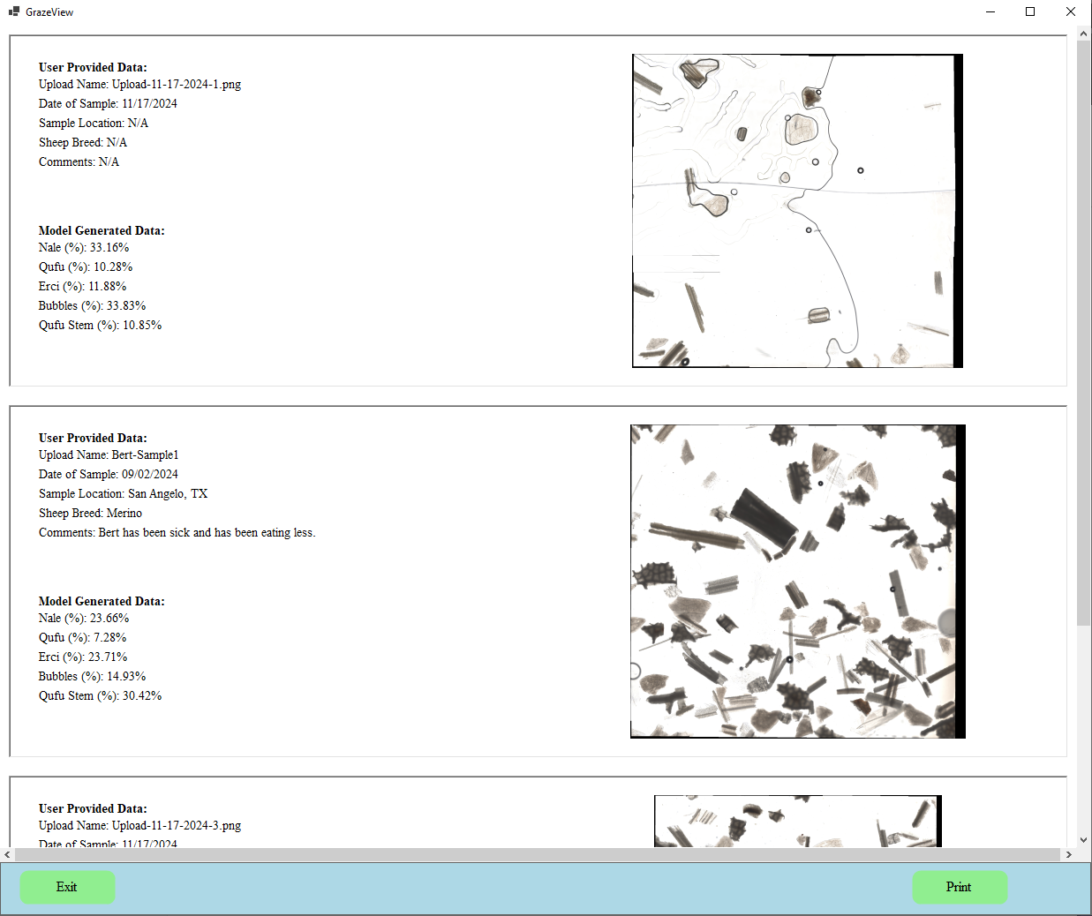
U.I. Visual Design
Nathan Scott

Slide 12
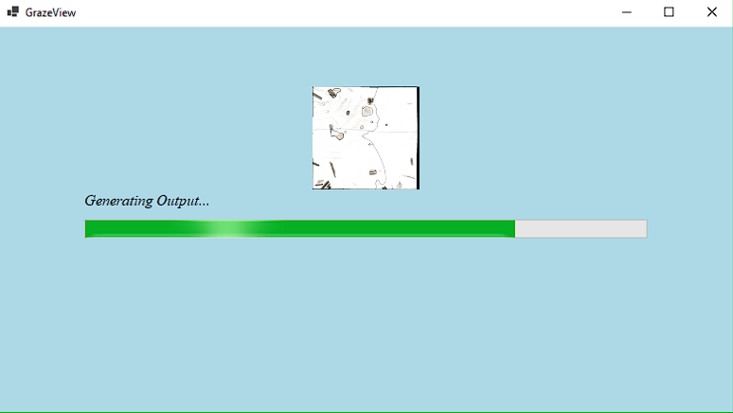
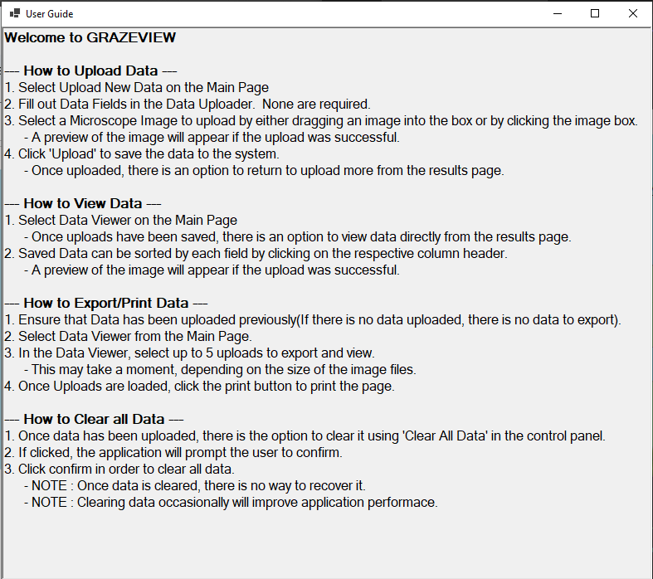
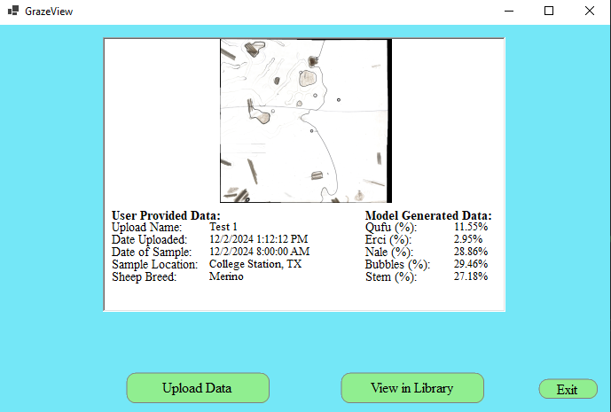
U.I. Visual Design
Nathan Scott

Slide 13
Machine Learning Model
Godson Edewor
Accomplishments since 403 [~70 Hours] | Ongoing progress/problems and plans until the next presentation
Four Feature convolutional neural net architecture has been designed and validated Percentage mapping is functional for nale, qufu, erci, and bubble The dataset to model pipeline is partially automated 80 - 85% overall model accuracy tested and validated 7 minuted training time for each model sample New Image processing has been validated | Focus will primarily be on integrating with the GrazeView web app Converting pretrained model to ONNX format for integration Complete the dataset automation by integrating with database

Slide 14
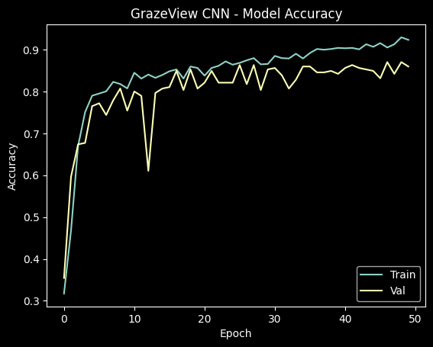
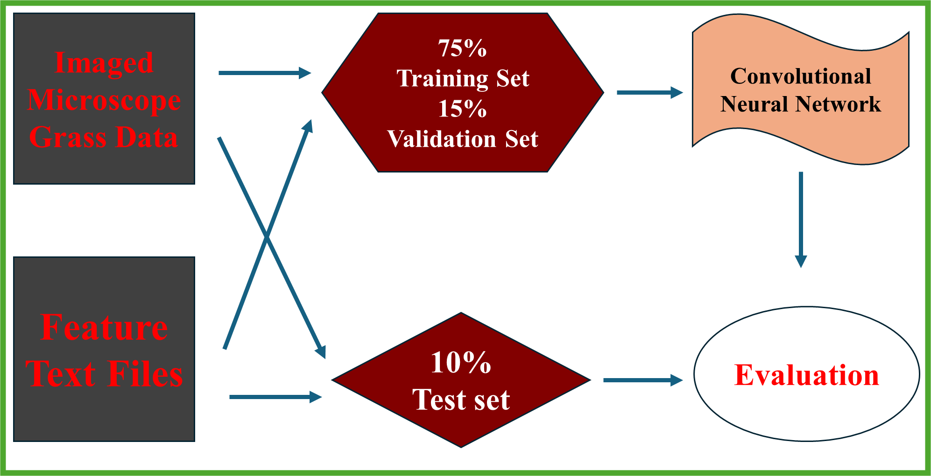
Machine Learning Model
Godson Edewor

Slide 15
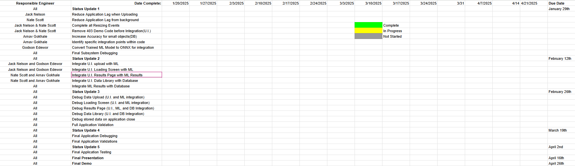
Execution & Plan
Notes:
Michelle

Slide 16
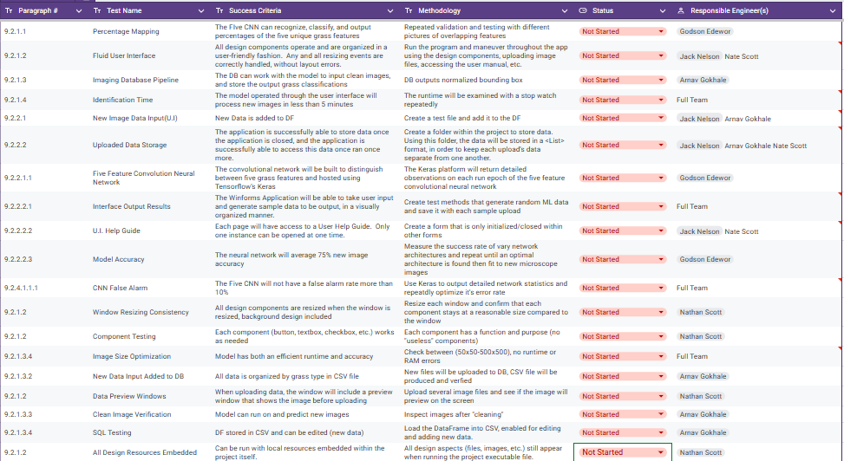
Validation Plan

Slide 17
Thank you!
Questions?

